Slide 1
A sustainable solar system
by Tran Hoang Hai Anh

Slide 2

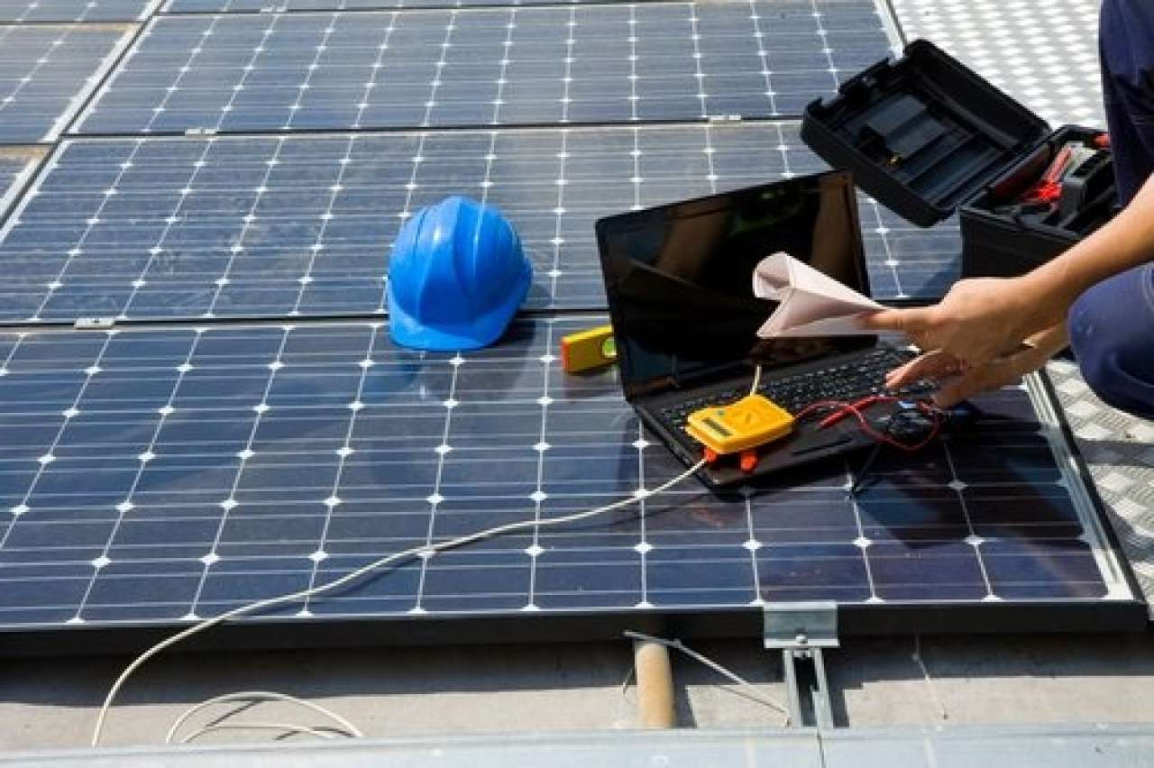
Learning issue/ problem
Importance of routine maintenance
Identifying performance difficulties
Basic maintenance procedures
Troubleshooting and problem solving
Seeking professional support

Slide 3
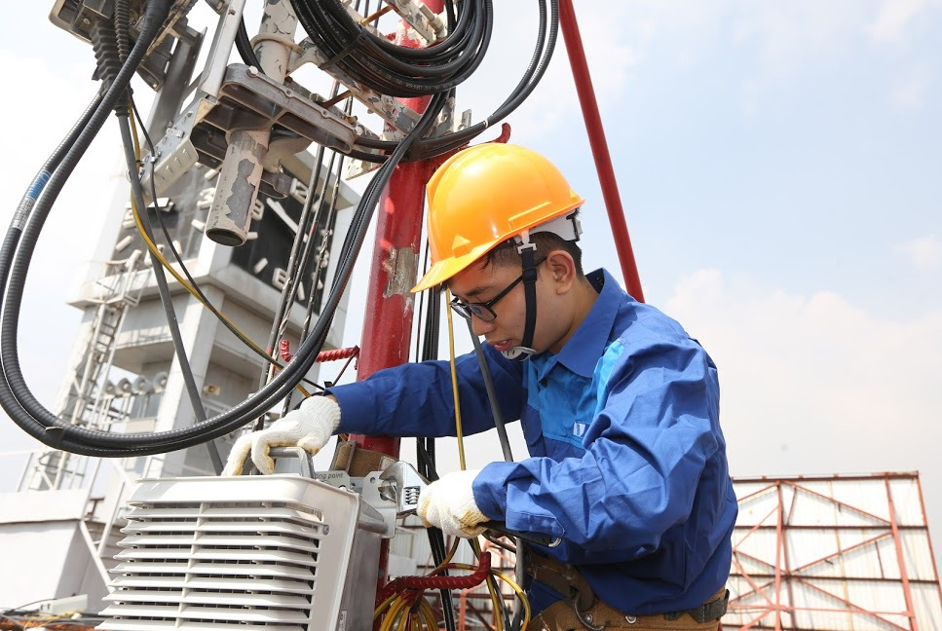
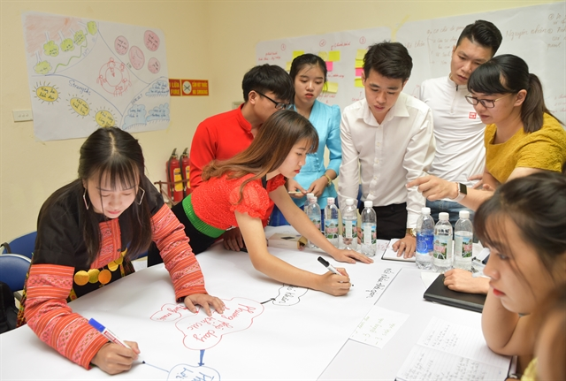
Design outline
Community training and education
Local technicians and support networks
Remote monitoring and diagnostic tools
Collaborative maintenance programs
Accessible platforms for collaboration

Slide 4

Design benefit
Improved system performance
Prolonged system lifespan
Local empowerment and skill development
Cost savings
Sustainable energy access

Slide 5
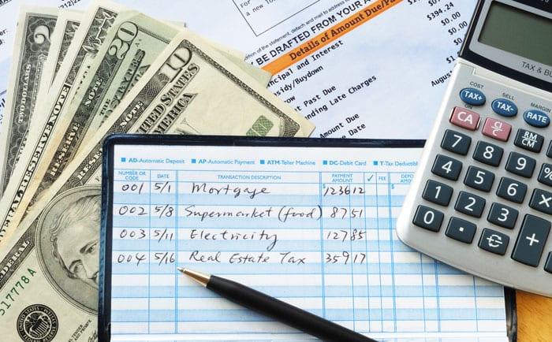
Estimation of the design budget
Design component | Estimated cost
Community training and education | $1000
Local technicians and support network | $1400
Remote monitoring and diagnostic tools | $1000
Collaborative maintenance programs | $800
Miscellaneous and Contingency | $400
Total estimated design budget | $4600

